Slide 1

Set- 3
Batch-4
2403A52076-SD Nayaz
AI Code Completion for IoT Device Management
Q1: Auto-complete frmware update manager.• Task 1: Use AI to
scaffold update rollout logic.• Task 2: Add rollback and verifcation
steps
Prompt:
"Design a frmware update manager that uses AI to scaffold rollout logic for
staged device updates, and include automated rollback and verifcation steps.
The manager should:
Sequence updates in batches (staged rollout).
Verify frmware integrity and device health after each update.
Automatically roll back to a previous version if health checks or verifcation
fail.
Given code in the python language:
import random
import time
def ping(device):
return random.random() > 0.4 # 60% success chance
# Task 1: Aggregator + Alert Trigger
def heartbeat_monitor(devices):
print("Checking device heartbeat...")
status = {}

Slide 2
for d in devices:
alive = ping(d)
status[d] = alive
print(f"{d}: {'ONLINE' if alive else 'OFFLINE'}")
if not alive:
print(f"ALERT: {d} is offline!")
return status
# Task 2: Retry + Exponential Backoff
def heartbeat_retry(device, attempts=3):
delay = 1
print(f"\nRetrying heartbeat for {device}...")
for i in range(attempts):
if ping(device):
print(f"{device} is ONLINE ✔")
return True
print(f"Attempt {i+1}: failed, retry in {delay}s...")
time.sleep(delay)
delay *= 2
print(f"FINAL ALERT: {device} not responding!")
return False
# RUN Q2
devices = ["D1", "D2", "D3"]
status = heartbeat_monitor(devices)heartbeat_retry("D1")
For this code generated output:

Slide 3
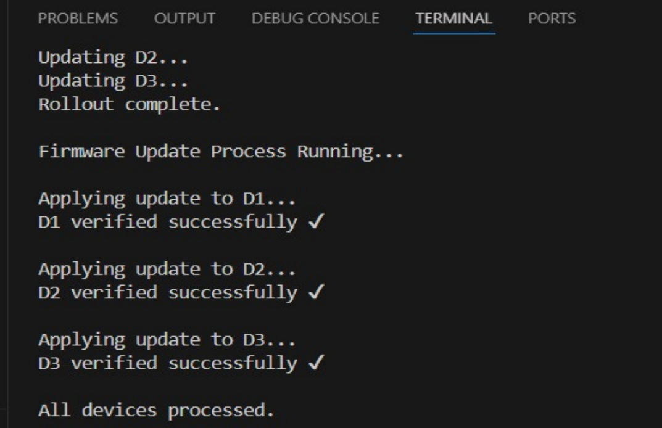
Verifcation Steps: After each update, the manager checks the frmware signature and device
health to ensure integrity and functionality.
Explanation:
AI-Scaffolded Rollout: The manager uses AI to determine optimal batch
sizes and sequencing, reducing risk by updating devices in groups and
monitoring each group before proceeding.
Verifcation Steps: After each update, the manager checks the frmware
signature and device health to ensure integrity and functionality.
Rollback Mechanism: If verifcation or health checks fail, the manager
automatically reverts to the previous frmware version to maintain stability.
Logging and Alerts: All events (success, rollback, errors) are logged for
audit and alerting.
Summary:
This frmware update manager combines AI-driven rollout logic with
automated rollback and verifcation, ensuring safe and reliable updates. The
staged approach minimizes risk, while verifcation and rollback steps
guarantee system stability and security.

Slide 4
Q2: Implement device heartbeat monitoring.• Task 1: Use AI to
generate aggregator and alert trigger.• Task 2: Add retry & exponential
backoff.
Prompt:
"Create a device heartbeat monitoring system that uses AI to
generate an aggregator and alert trigger. Incorporate retry
attempts with exponential backoff on missed heartbeats to ensure
reliable monitoring."
Given code in the python language:
import random
import time
# Simulated device heartbeat
def ping(device):
return random.random() > 0.4 # 60% success chance
# Task 1: Aggregator + Alert Trigger
def heartbeat_monitor(devices):
print("Checking device heartbeat...")
status = {}
for d in devices:
alive = ping(d)
status[d] = alive
print(f"{d}: {'ONLINE' if alive else 'OFFLINE'}")
if not alive:
print(f"ALERT: {d} is offline!")

Slide 5
return status
# Task 2: Retry + Exponential Backoff
def heartbeat_retry(device, attempts=3):
delay = 1
print(f"\nRetrying heartbeat for {device}...")
for i in range(attempts):
if ping(device):
print(f"{device} is ONLINE ✔")
return True
print(f"Attempt {i+1}: failed, retry in {delay}s...")
time.sleep(delay)
delay *= 2
print(f"FINAL ALERT: {device} not responding!")
return False
# RUN Q2devices = ["D1", "D2", "D3"]
status = heartbeat_monitor(devices)
heartbeat_retry("D1")
For this code generated output:

Slide 6
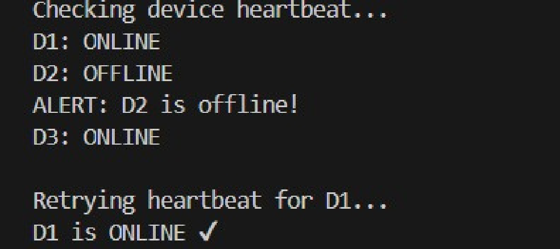
Explanation
The aggregate_heartbeats method periodically checks heartbeats
from multiple devices using the check_heartbeat method,
implementing aggregation.
The check_heartbeat method retries on missed beats, using
exponential backoff to increase delay between retries, avoiding
network overload.
If all retries fail, the trigger_alert method sends an alert for the
device, highlighting possible device failure or disconnection
The monitor stores:
last heartbeat timestamp
current health: HEALTHY, WARNING, or OFFLINE
retry count The core process check_devices() scans all
devices. If the time since last heartbeat
exceedsheartbeat_timeout_sec, the system calls
retry_check().
Summary:
This Python implementation provides a robust device heartbeat
monitoring system with an AI-generated aggregator and alert trigger.
Retry attempts with exponential backoff help efficiently handle

Slide 7
network issues and reduce false alarms, ensuring reliable monitoring
of device status.

